Slide 1
CSCE 823 In Class Day 09
ANN Training: Optimization (2)
Live Synchronous session

Slide 2
Agenda
Optimization improvements (part 2)
Coding Activity (batch normalization)
Break (if needed)
General Q&A

Slide 3
Optimization Improvements
Basic SGD w/ learning rate decay (8.3.1)
Momentum (8.3.2)
Nesterov Momentum (8.3.3)
Parameter Initialization (8.4)
AdaGrad (8.5.1)
RMSProp (8.5.2)
Adam (8.5.3)
Newton’s Method
Conjugate Gradient Methods
BFGS
Supervised Pretraining (8.7.4)
Other model improvements (8.7.5)
Batch Normalization (8.7.1)
Continuation Methods and Curriculum Learning
Improving the Learning Algorithm
Other Training Improvements

Slide 4
Learning Algorithm Improvements
Most common / favorite choices besides SGD

Slide 5
RMSProp intuition
Like AdaGrad – adjust LR per parameter – but…
Instead of keeping total history of partial gradients, use a moving average of the partial gradient
Should make the algorithm more aware of the local parameter space than AdaGrad

Slide 6
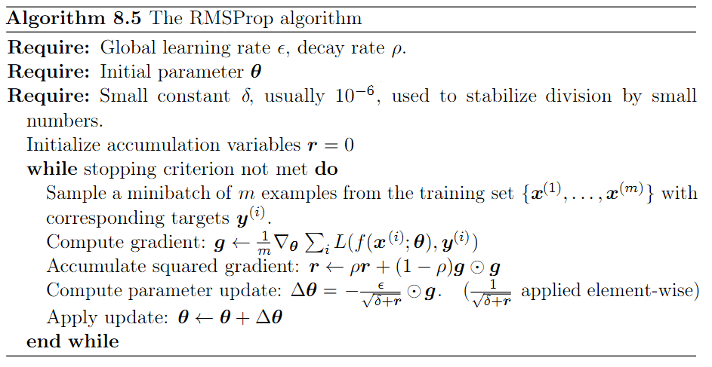
RMSProp
Achieves the moving average
Of the squared gradient

Slide 7
Adam Intuition
Like RMSProp with momentum
Momentum incorporated as estimate of the first-order moment of the gradient
Adds corrections to make first and second-order terms account for initialization at the origin
Well-liked: performance is robust to choice of hyperparameter decisions
with exception of learning rate which might need adjusting

Slide 8
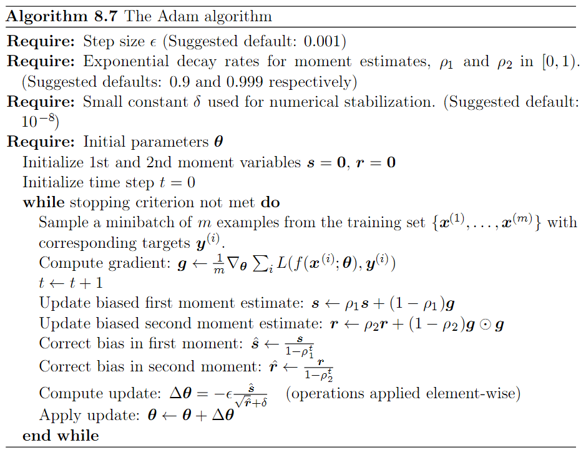
Adam Algoritm

Slide 9
Other Training Improvements
Training bigger/deeper networks by altering things other than the learning algorithm

Slide 10
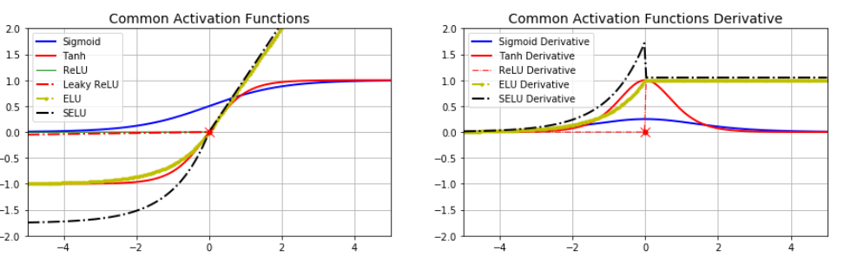
Other Training Improvements (activation function - beyond the sigmoid)
Activation Function Improvement
Old concept: activation functions should be differentiable almost everywhere
Enables easy optimizers like SGD; BUT require more computation, and because sigmoids have large low-gradient tails, slower convergence
New idea: simpler is more important than cont. differentiable activation functions (e.g. ReLU)
Gradient flows better through layers during backprop; BUT discontinuity and no gradient left of zero
Newer idea: approximations of ReLU such as leaky ReLU, exponential LU …
behave similar to ReLU without the discontinuity or the zero gradient weakness;
… at the cost of more difficult computation

Slide 11
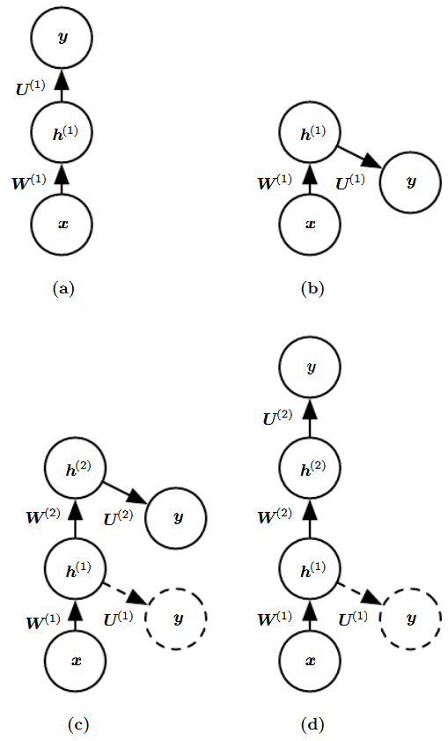
Early idea… Supervised Pretraining
A collection of techniques where portions of a sub-network are trained separately from the final full network; once trained, combine (with fine tune training)
Allows gradients to be experienced by layers that would otherwise not experience them
Faster (greedy) training
Generally not used in recent history due to newer solutions…

Slide 12
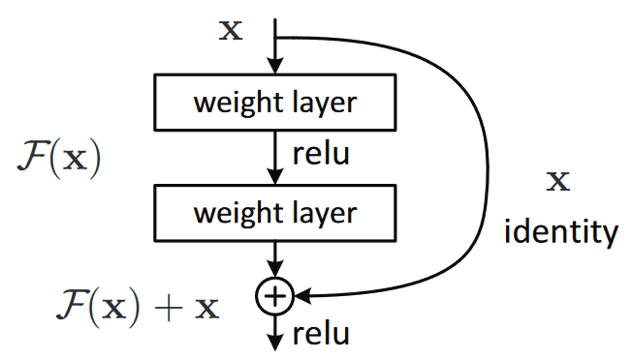
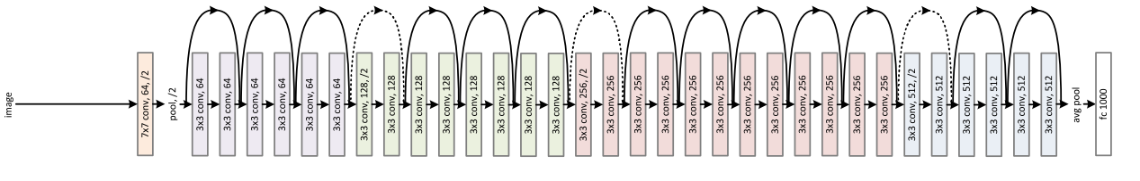
Other Model Improvements (beyond serial layer composition)
Serial layer constructions force each layer to alter the loss gradient as it passes to earlier layers during backprop
After many layers of backprop the information contained in the gradient can be lost (e.g. diluted via vanishing), making training deep networks challenging
New Idea: Skip connections and residual blocks allow later-layer gradients to skip some layers and directly affect earlier layers – more of the loss information is propagated backwards, making deeper networks trainable
https://kharshit.github.io/blog/2018/09/07/skip-connections-and-residual-blocks

Slide 13
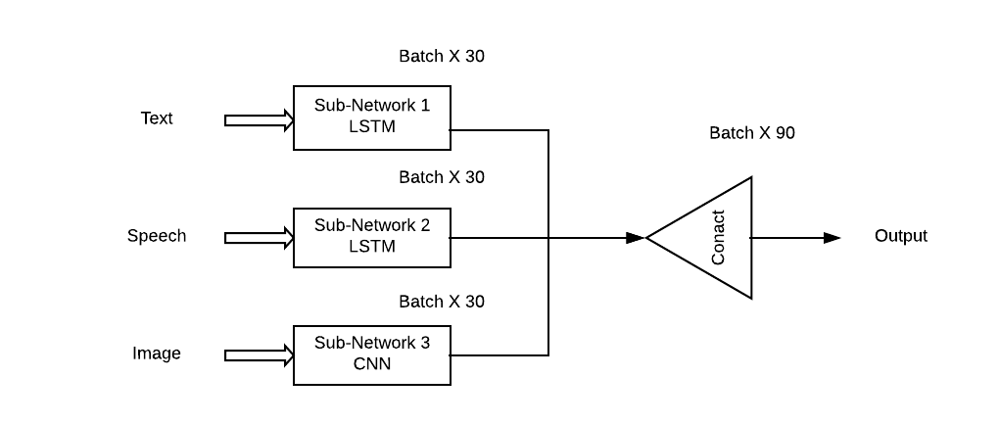
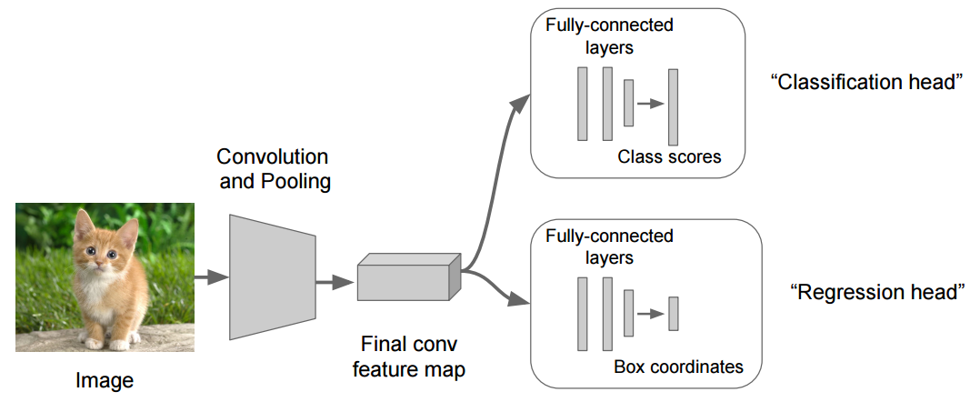
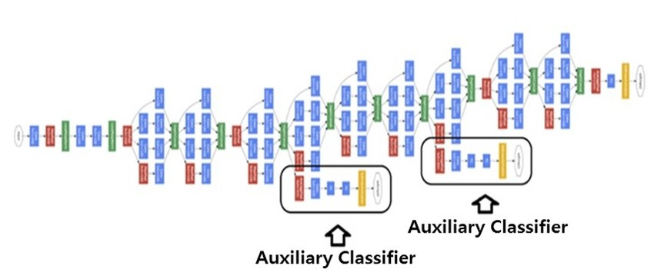
Other Model Improvements (beyond serial layer composition)
Multi input/output
Multimodal: allow multiple input types with fusion (e.g. audio+video or image + text)
Multi-Head: multiple tasks (e.g. regression and classification; location and classification of object in an image)
https://towardsdatascience.com/multimodal-deep-learning-ce7d1d994f4
https://stackoverflow.com/questions/56004483/what-is-a-multi-headed-model-and-what-exactly-is-a-head-in-a-model/56004582
https://paperswithcode.com/method/auxiliary-classifier

Slide 14
Batch Normalization
In backprop, gradients are computed per layer, working backwards from output toward input
Deep networks may have trouble propagating loss a long way back because a layer make take “more than it’s share of the blame”
Too easy to shift mean or variance of a layer
Key idea: replace activations at a layer with z-scaled activations at a layer during training
Prevents the layer from arbitrarily shifting mean or variance when computing weight updates

Slide 15


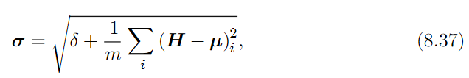

Batch Normalization Technique
$$\text{Given} \text{a} \text{set} \text{of} \text{forward} \text{propagation} \text{activations} \text{of} \text{a} \text{layer}\text{:} H_{i,j}$$
$$\text{where} i \text{indexes} \text{the} \text{minibatch} \text{observation} \text{number}$$
$\text{and} j \text{indexes} \text{the} \text{node} \text{number} \text{in} \text{the} \text{layer}$
During training, use the following activations during the backpropagation:
Where μ is a row vector: the mean (over the minibatch) per activation unit:
(m is the minibatch size)
And σ is a row vector: the standard deviation (over the minibatch) per activation unit
δ Is 10⁻⁸ . Helps avoid undefined gradient at 0

Slide 16
Learning Activity 20-minute breakout groups
Code walkthrough
Implement (simple) Batch Normalization in your group
Run on data-augmented XOR
Observe performance of BN True vs. BN False
Post-activity discussion
Simple BN means it is calculated per batch (not a running average)

Slide 17
Break

Slide 18
General Q&A

Slide 19
Backup Slides

Slide 20
AdaGrad intuition
Key idea – adapt the learning rate for each parameter separately
Goal: make more progress in gently sloped areas of parameter space
Algorithmically:
LR is inversely proportional to historical squared gradient of partial derivatives
Steep grad histories -> smaller learning rate
Shallow gradient history -> larger learning rate
Works sometimes…

Slide 21
J(θ) Solution Space
Eigenvalues: all positive all negative some positive, some neg
We hope for global minimum
Could be local minimum
High dimensional θ is more likely to yield mostly saddle points
Due to random matrix theory – it is unlikely that in a high-D space, movement in every dimension leads to lower cost

Slide 22
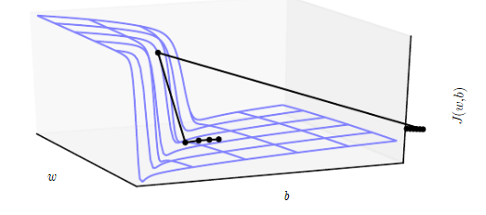
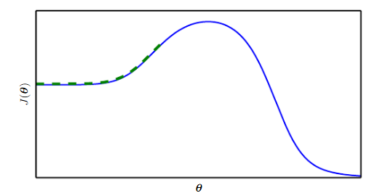
Non-saddle point SGD training challenges
Problems
Solutions
Cliffs and exploding gradients
Local gradient not aligned with global solution
Gradient Clipping
Longer training in higher dimensional search
start
end

Slide 23
Minima: Local v Global v Saddle (in high-D spaces)
Taking advantage of high-D probabilistic theory…
Saddle points likely to be higher in cost J(θ)
Rationale: one or more vectors lead to lower cost
Local minima in high-D spaces are likely to be low in J(θ) – thus they represent good solutions
Rationale: in a local minimum, movement in any of the many possible dimensions increases cost
Thus: Most (local) minima are good (enough) – especially in big models

Slide 24
(new) Interpretation of SGD
SGD usually moves downhill
SGD eventually encounters critical point (…slope ~ 0…)
Usually a saddle point, occasionally a local minimum
Will SGD get stuck forever in a saddle since it fails to exploit negative curvature in saddle? … probably not – it could escape them … But there are optimization challenges which have encouraged researchers to develop improvements

